Slide 1
BRAND GUIDELINES
A Consistent Customer Journey
Brand Guidelines 2023

Slide 2
TABLE OF CONTENTS
01
02
03
04
05
06
07
08
09
10
Introduction
History
Brand Overview
Fare Brands & Ancillaries
Logo and Description
Logo Anatomy
Proper Logo Use & Approval Process
Color Palette
Approved Imagery
Approval Process

Slide 3
01
A CONSISTENT CUSTOMER JOURNEY
SENTRA AIRWAYS
BRAND GUIDELINES 2025

Slide 4
02
BRIEF HISTORY
How We Started
From the founders vision "Sentra" was conceived from the basis of an organization and airline that remains centred and safe at all times
BRAND GUIDELINES 2023

Slide 5
BRAND SLOGAN
Best value airline, tailored to your lifestyle.
BRAND GUIDELINES 2023

Slide 6
BRAND VALUES
06
Pioneers of future change
Respect our customers
Obsessed with customer satisfaction
Uncompromised safety
Driven by customer needs & distinctive service
Austen Tech
BRAND GUIDELINES 2023

Slide 7
OUR FARE BRANDS
Representing the best value for all our passengers to peronalize their flying experience while ensuring our fare brand & product offerings are market relevant and price competitive.
Sentra
Sentra Premium
Sentra Extra
Our core Economy fare brand(s)
Our core Premium Economy fare brand
Our core Business fare brand
sentra
sentra
sentra
premium
extra
Saver
Comfort
Priority
Flex

Slide 8
LIVERY
06
Austen Tech
BRAND GUIDELINES 2023

Slide 9
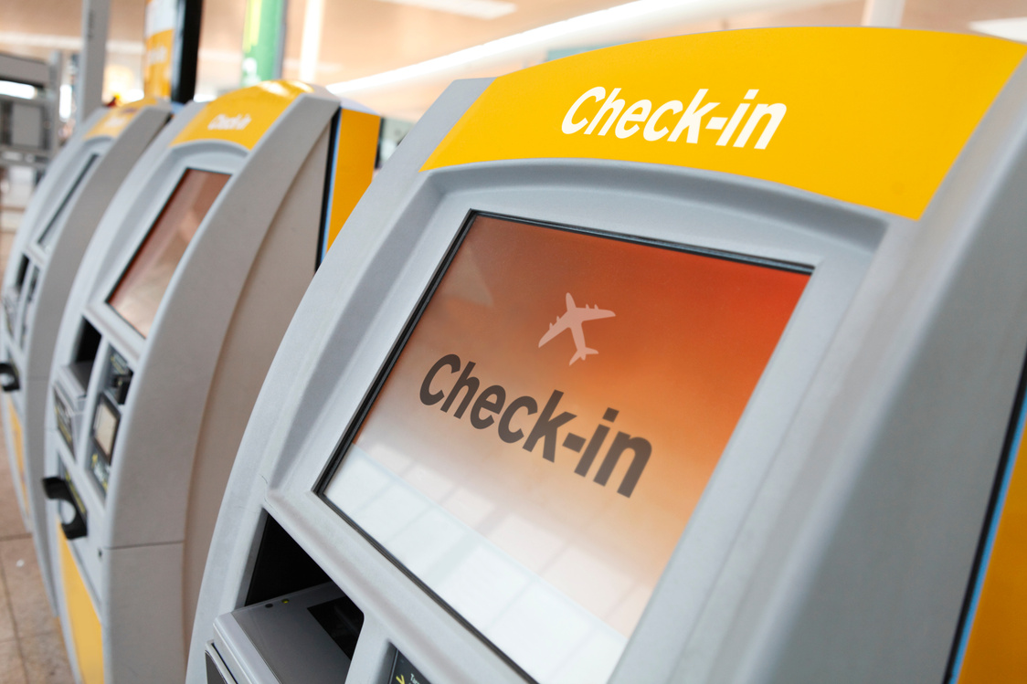
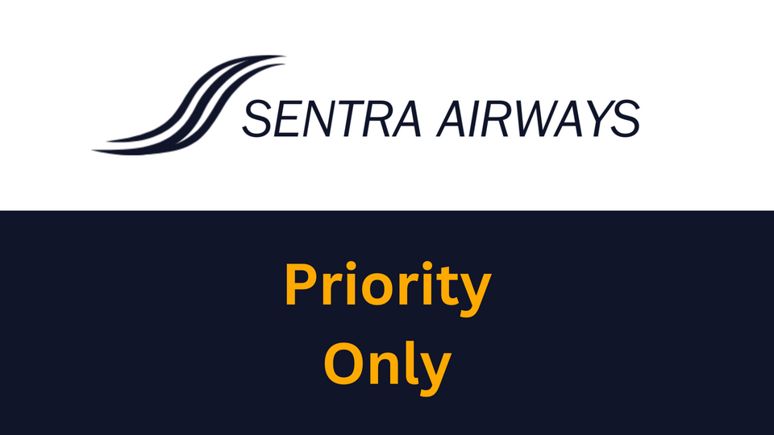
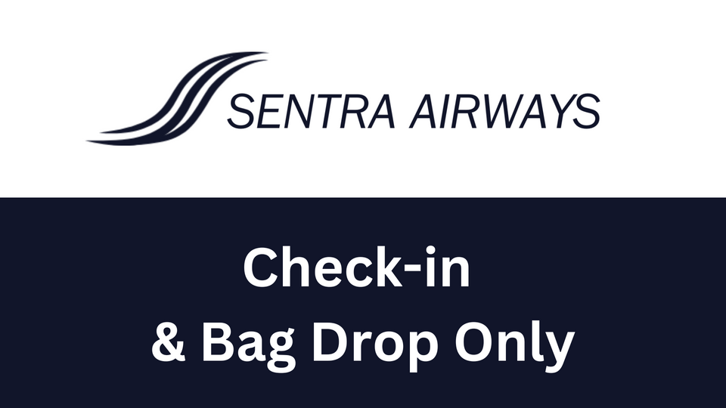
AIRPORT
06
Austen Tech
BRAND GUIDELINES 2023

Slide 10
AIRPORT
06
Austen Tech
BRAND GUIDELINES 2023

Slide 11
LOGO VARIATIONS
05
The Two Types
Main Logo
Secondary Logo
The main logo can also be inverted
The main logo combines the Sentra "S" with the brands written name. This is display horizontally and can be used with any of the brands main colours
The secondary logo is simply the Sentra Airways "S" which may be used with any of the brands main colours
Using any combination of the brand main colour palette
Austen Tech
BRAND GUIDELINES 2023

Slide 12
MAIN LOGO ELEMENTS
06
The Logo Mark
Word Mark
The "S" is the main logo element
Austen Tech
BRAND GUIDELINES 2023

Slide 13
PROPER LOGO USAGE
07
Rules of Application
Do's and Dont's
Do use the brand logo in any form per the brand guidelines.
Do not use pixelated versions of the logo and in all cases try to use the highest quality formats available.
Do visit our brand centre for the latest available graphics formats (www.sentraairways.com/brand).
Due to resource constraints we will not be able to provide custom graphics but our brand centre will contain all pre-approved formats
If/when in doubt please reach out to our marketing team for final approvals before production of assets to avoid errors (marketing@sentraairways.com).
BRAND GUIDELINES 2023

Slide 14
PROPER LOGO PLACEMENT
08
Usage Examples
Physical Assets
Digital Assets
Promotional
BRAND GUIDELINES 2023

Slide 15
BRAND TYPOGRAPHY
09
Aa
MAIN FONT
Aa Bb Cc Dd Ee Ff Gg Hh Ii Jj Kk Ll Mm Nn Oo Pp Qq Rr Ss Tt Uu Vv Ww Xx Yy Zz
1 2 3 4 5 6 7 8 9 0
Franklin Gothic LT
Franklin Gothic LT Bold
Franklin Gothic LT Italic
When possible, please use ITC Franklin Gothic LT
BRAND GUIDELINES 2023

Slide 16
CORPORATE COLORS
13
Main
The main colours to be used with all core Sentra Airways brand creative
Hex Code
#1F3053
Hex Code
#8793A7
Hex Code
#495D78
Hex Code
#11152A
CMYK
63% 42% 0% 67%
CMYK
19% 12% 0% 35%
CMYK
39% 23% 0% 53%
CMYK
60% 50% 0% 84%
RGB
31-48-83
RGB
135-147-167
RGB
73-93-120
RGB
17-21-42
BRAND GUIDELINES 2023

Slide 17
SECONDARY COLORS
13
Main
These colours are only to be used in conjunction with Sentra's fare brands.
Hex Code
#760200
Hex Code
#2C2C3A
Hex Code
#0146CB
Hex Code
#3a3a3b
Hex Code
#FFAA01
CMYK
0% 98% 100% 54%
CMYK
24% 24% 0% 77%
CMYK
100% 66% 0% 20%
CMYK
0% 0% 0% 77%
CMYK
0% 33% 100% 0%
RGB
118-2-0
RGB
44-44-58
RGB
1-70-203
RGB
58-58-59
RGB
255-170-1
BRAND GUIDELINES 2023

Slide 18
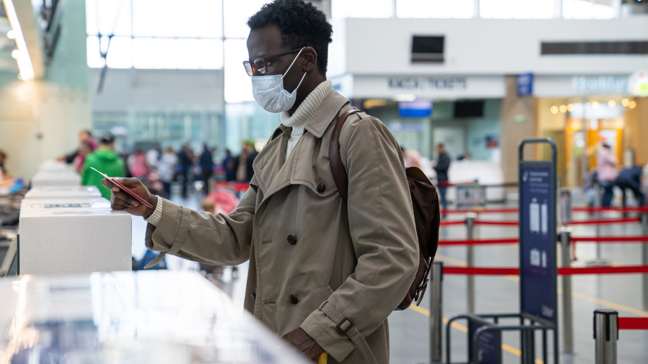
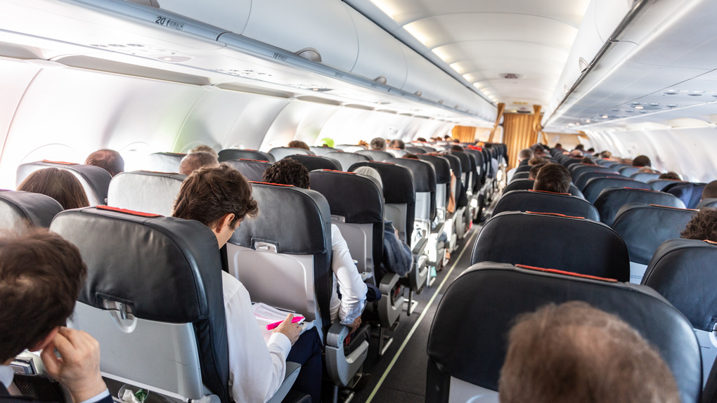
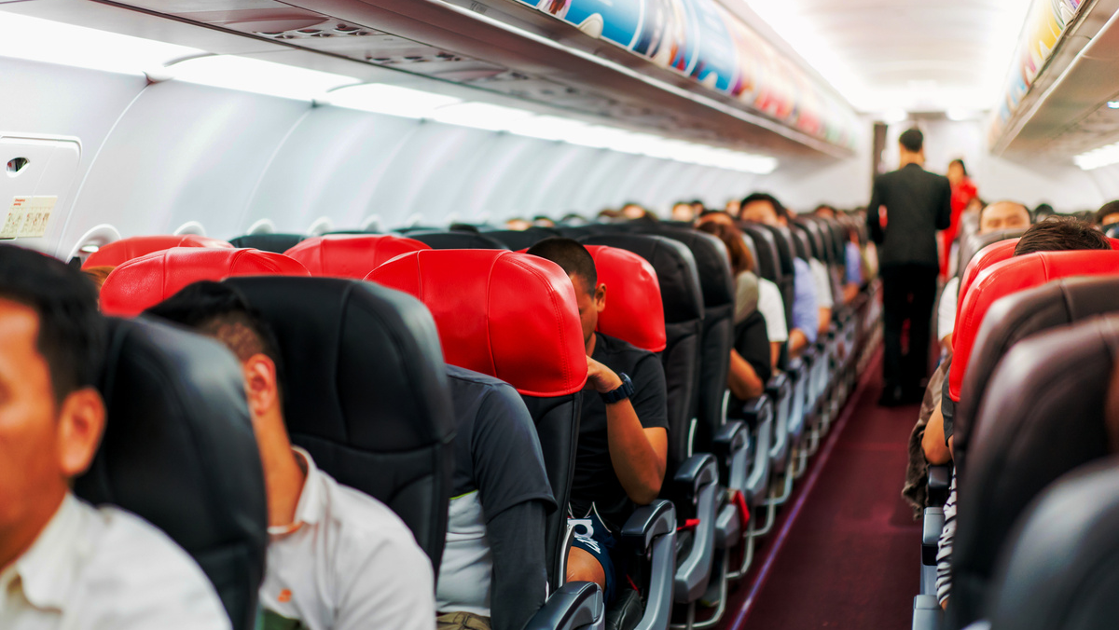
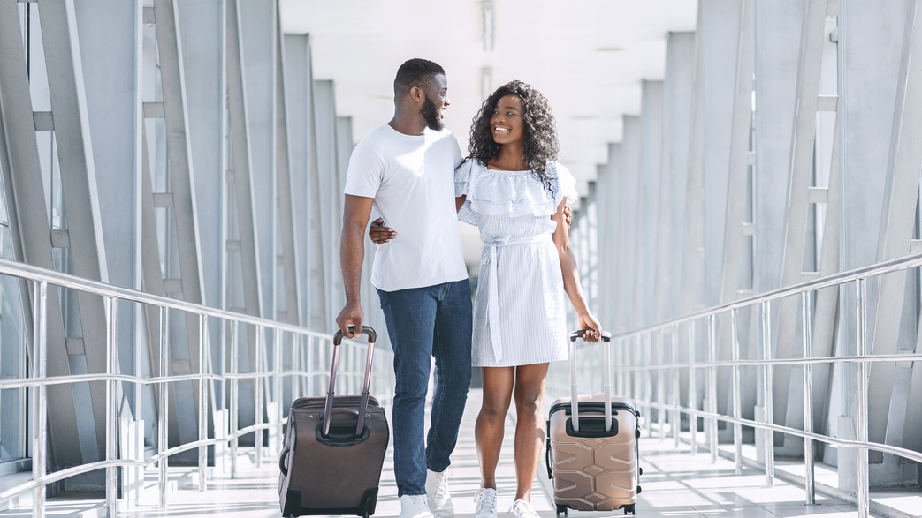
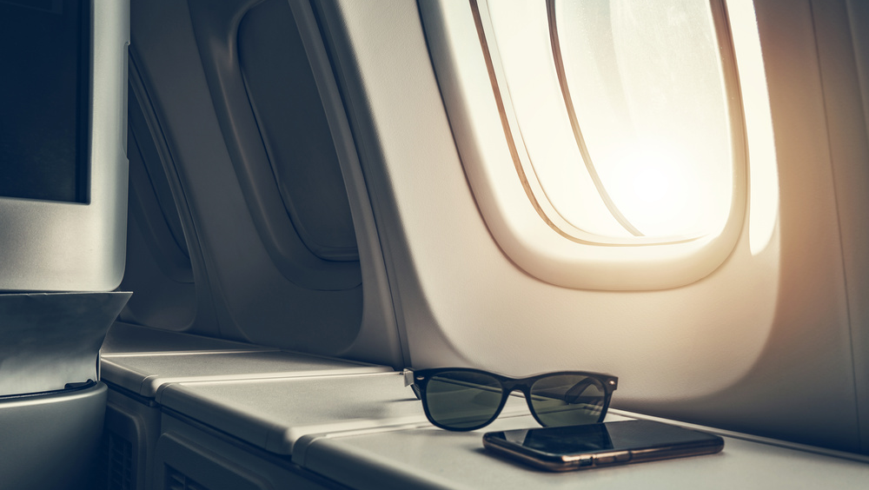
PROPER IMAGERY - TRAVEL
15
BRAND GUIDELINES 2023

Slide 19
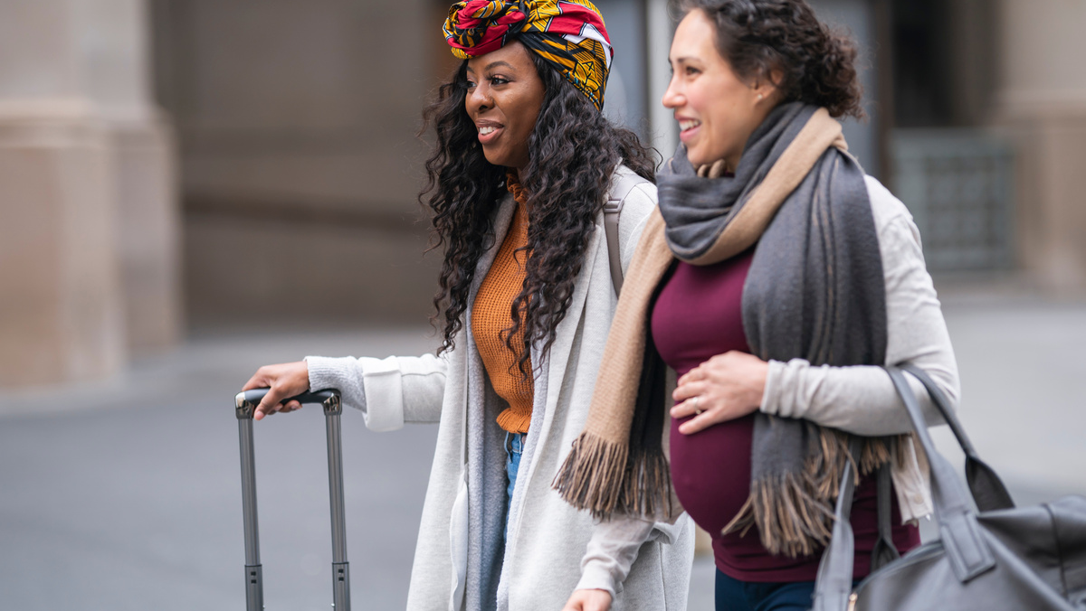
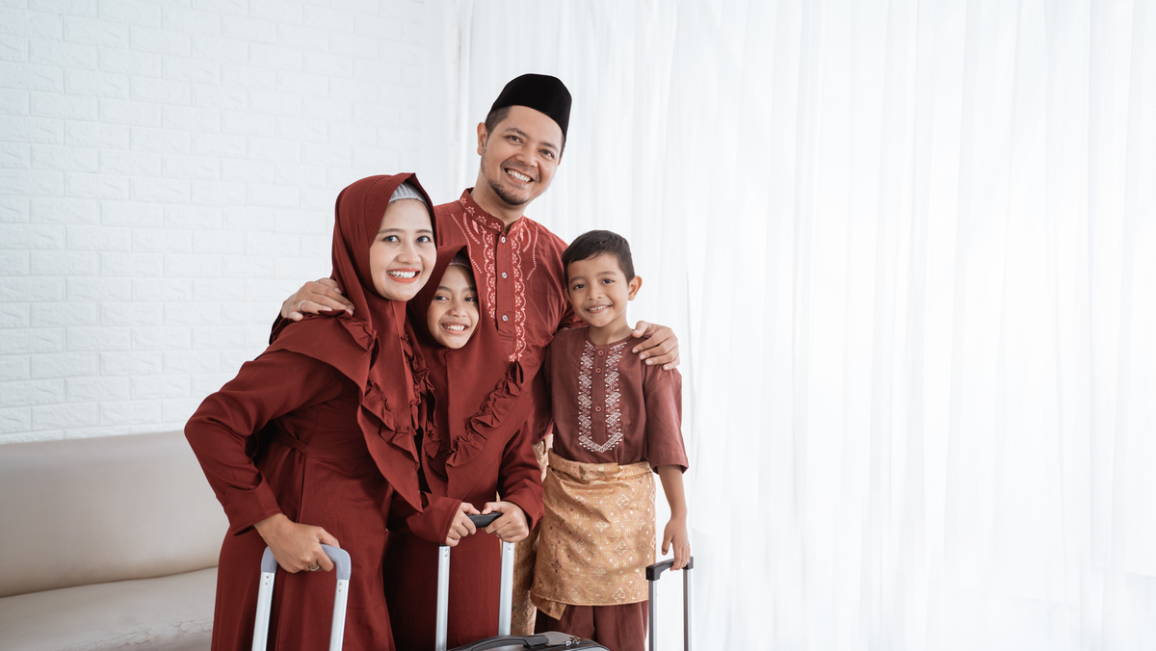
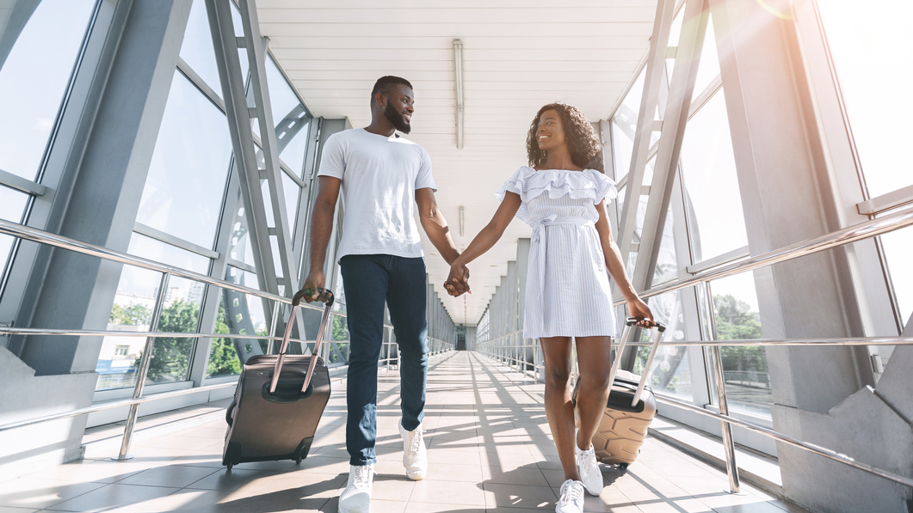
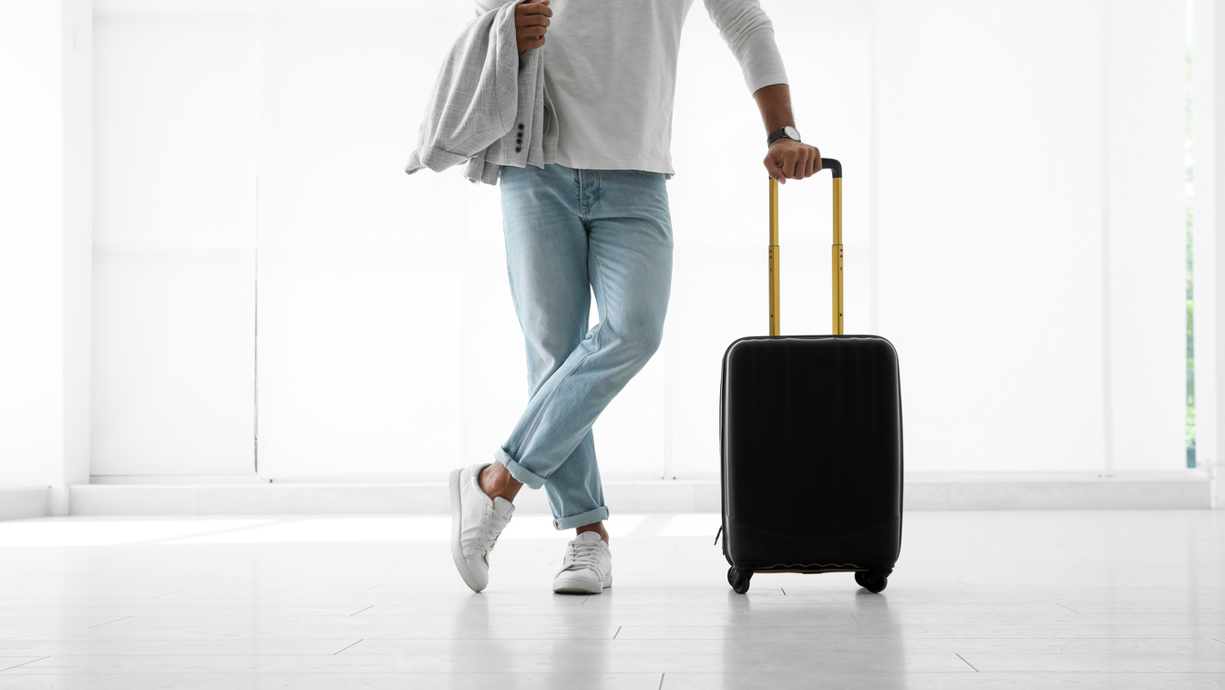
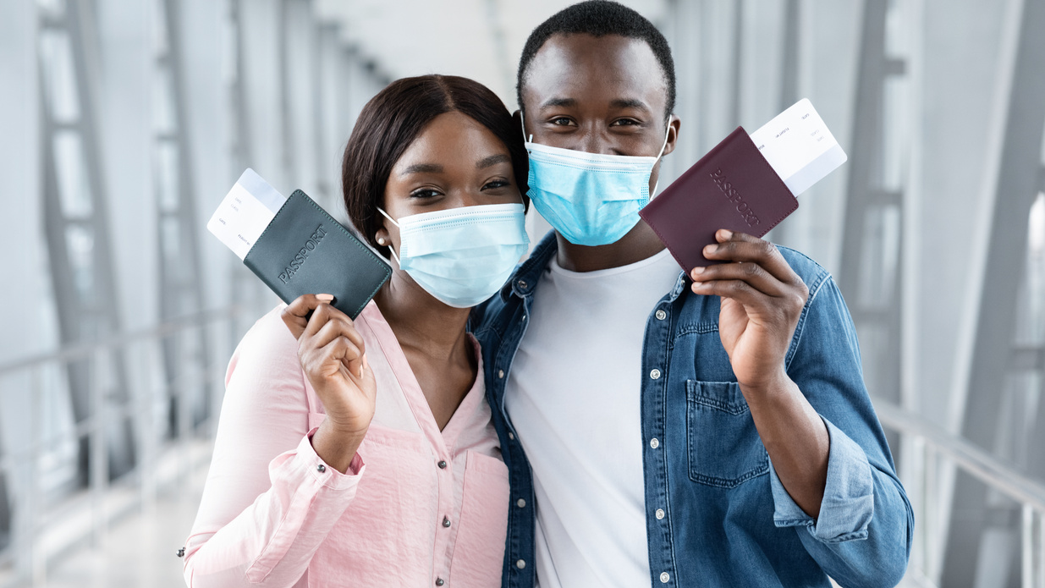
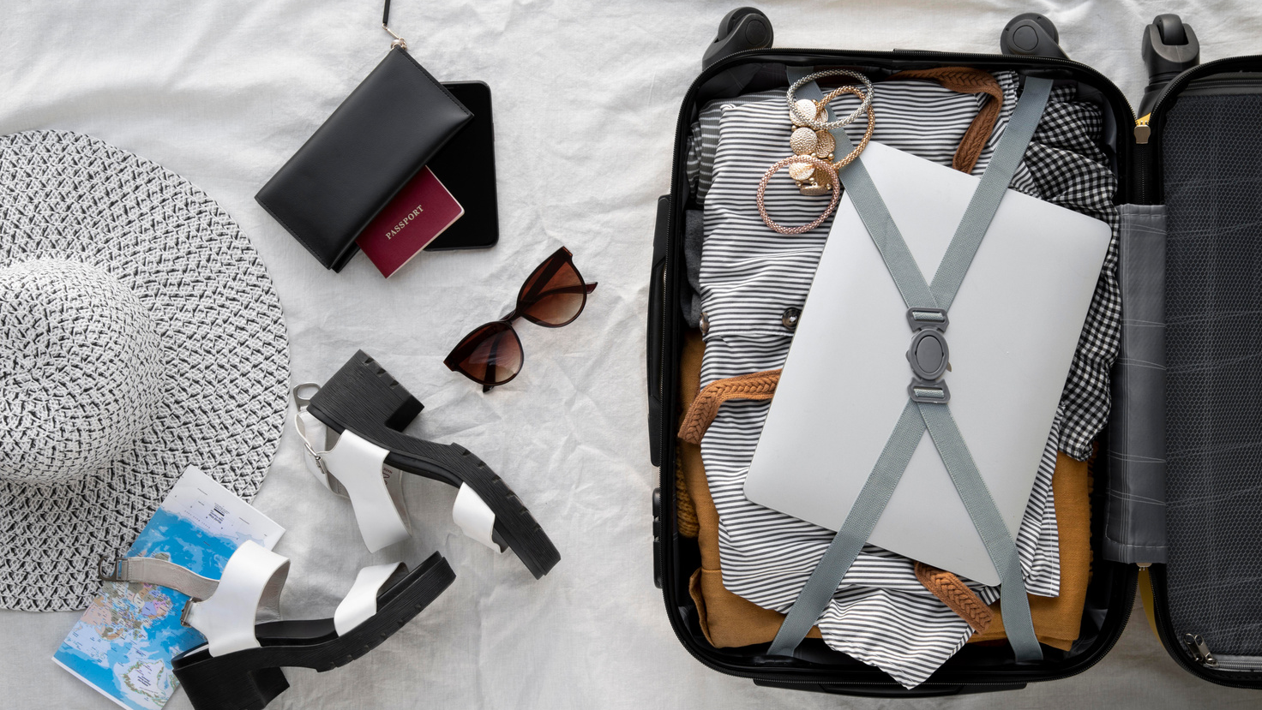
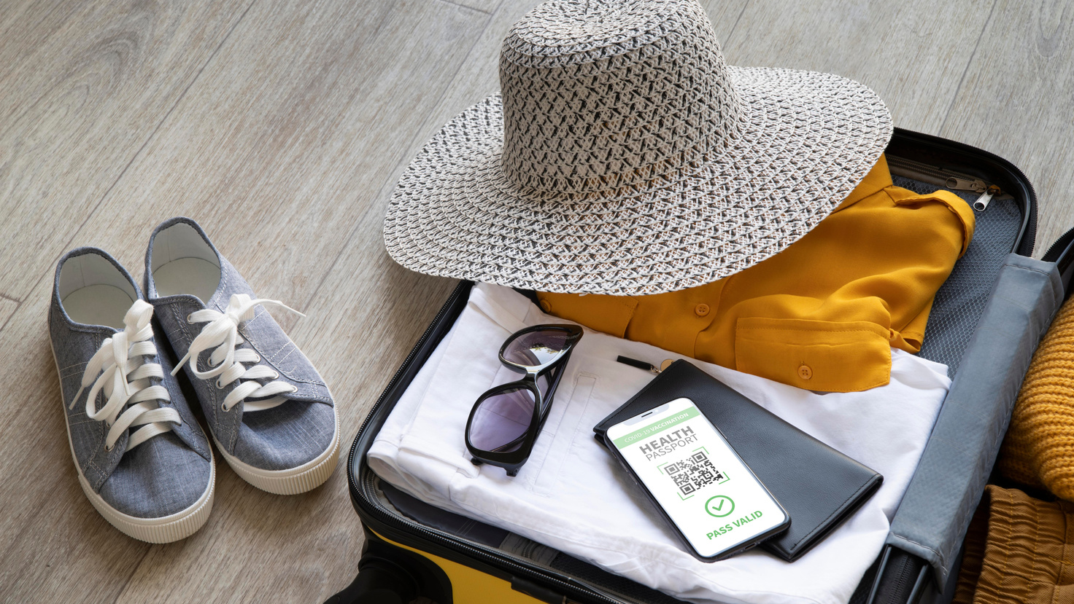
PROPER IMAGERY - TRAVEL
16
BRAND GUIDELINES 2023

Slide 20
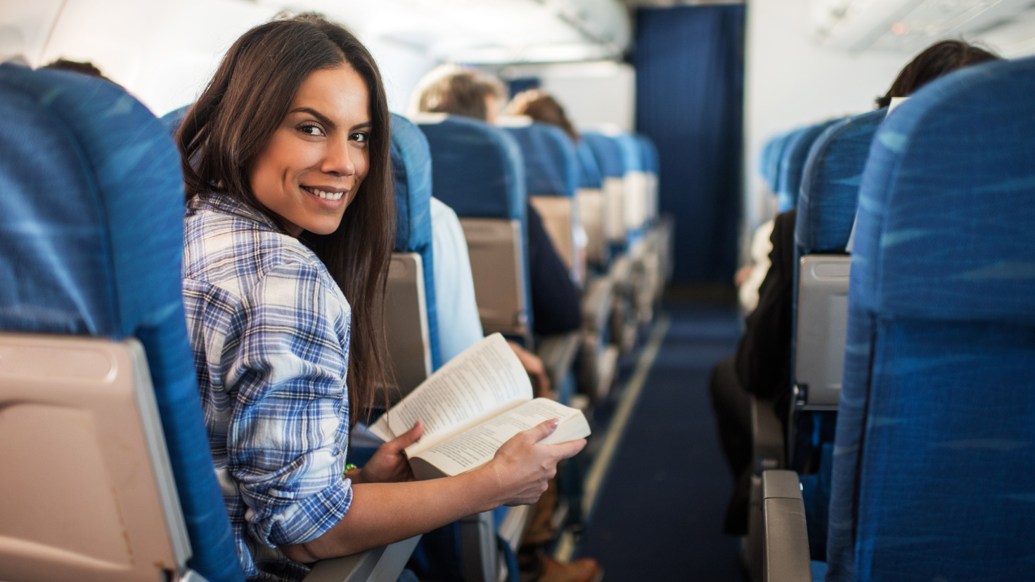
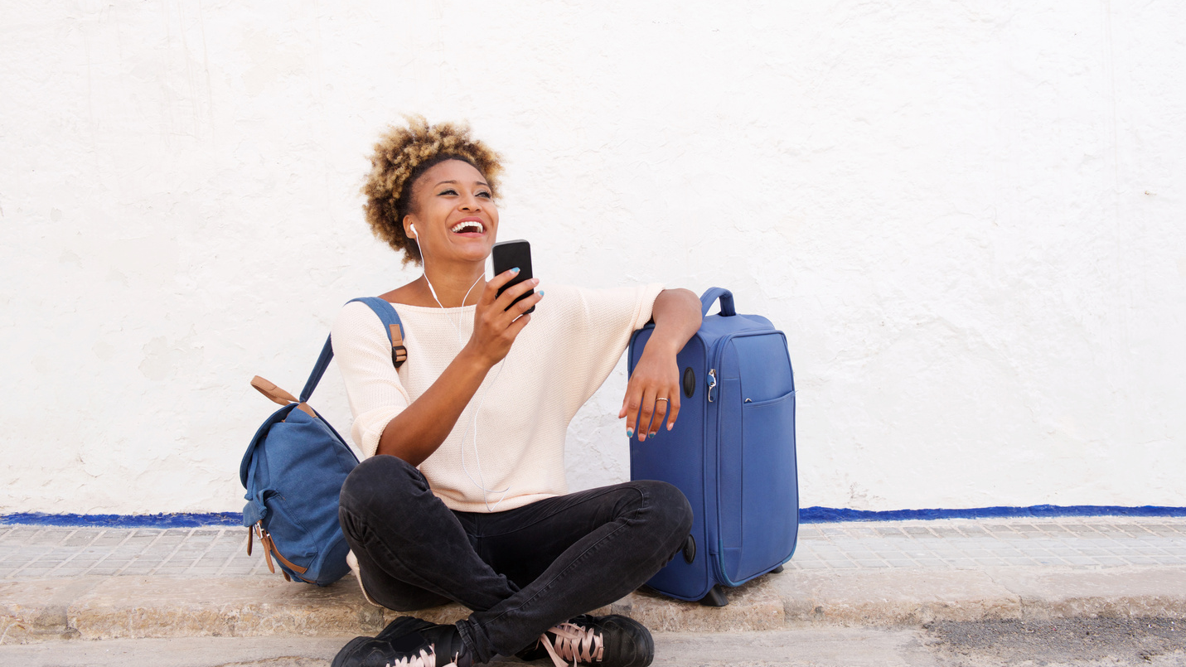
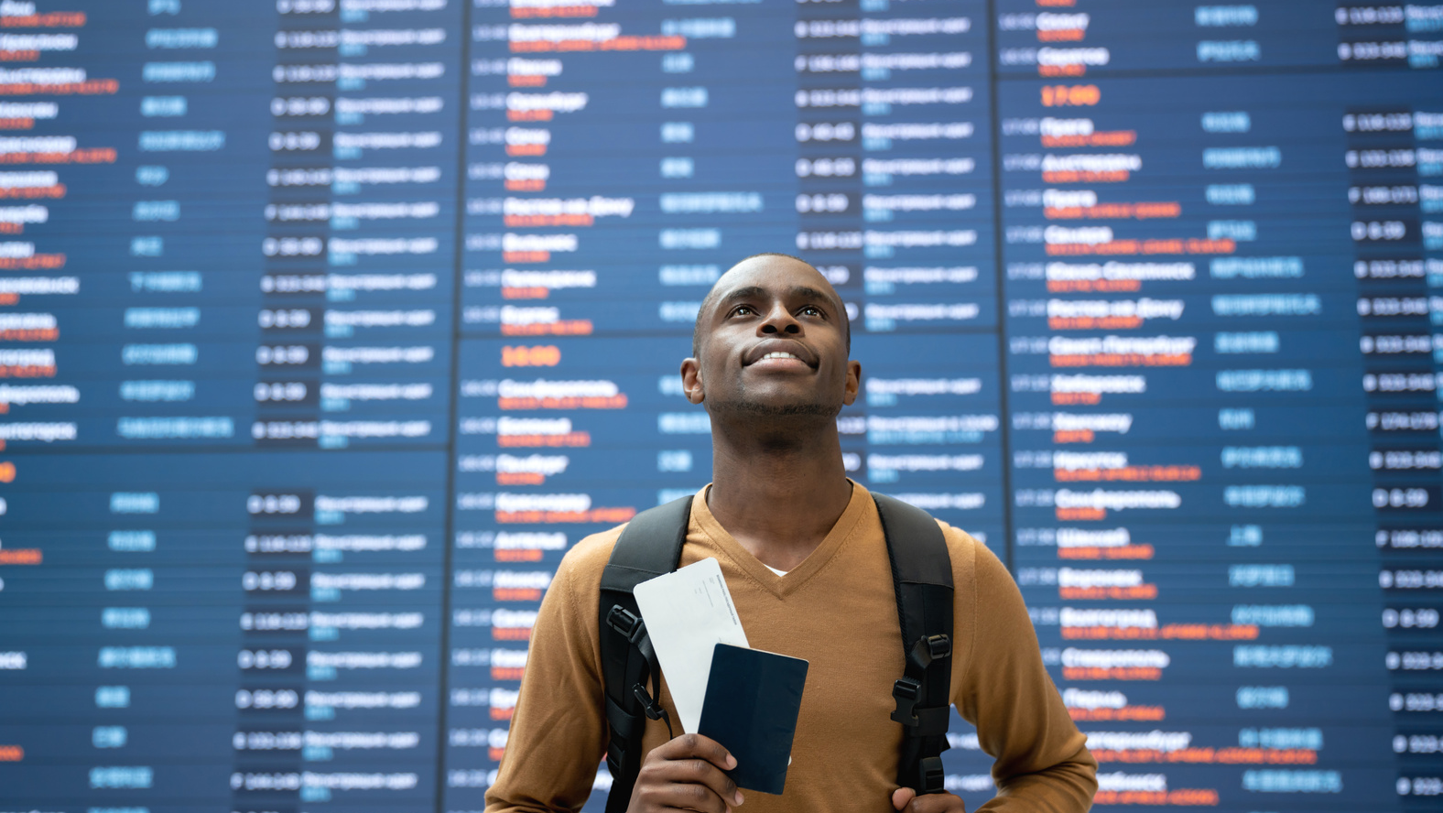
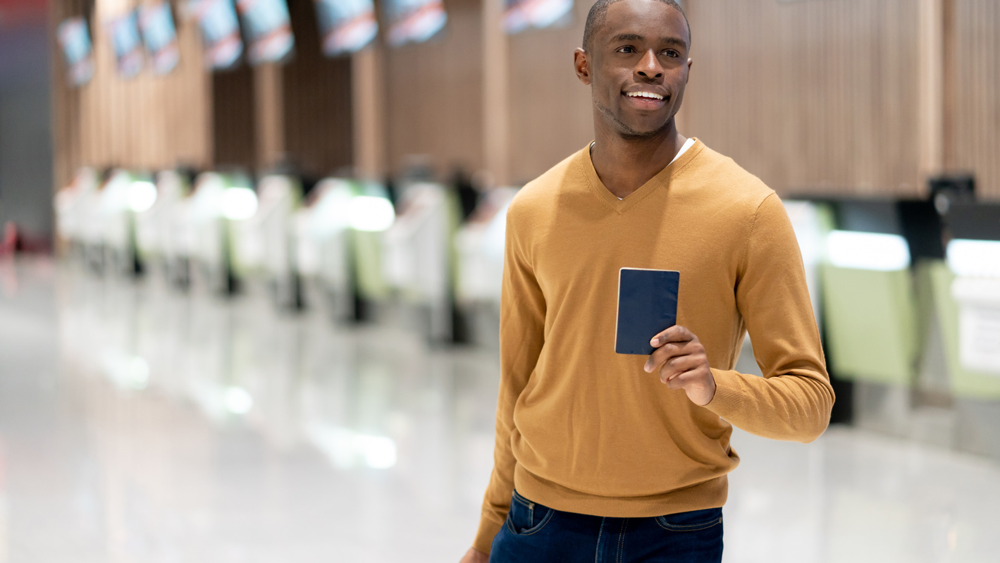
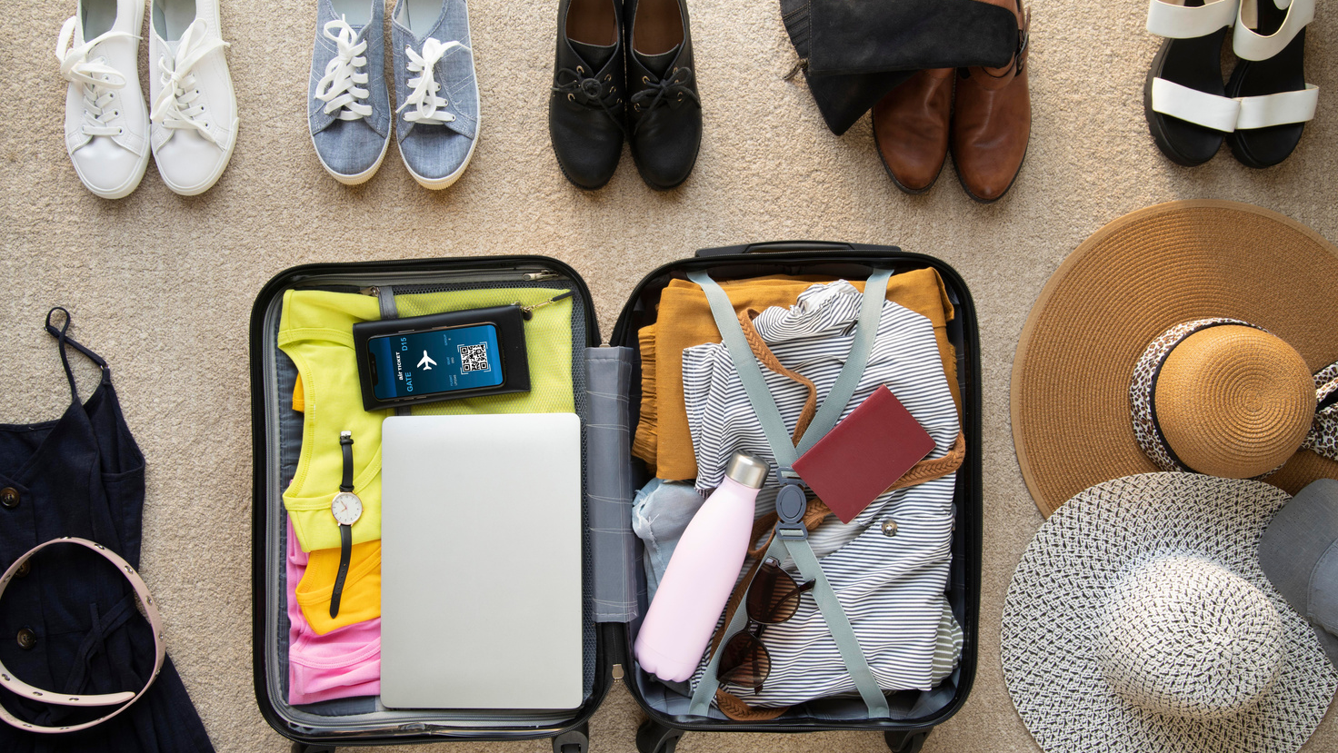
PROPER IMAGERY - TRAVEL
16
BRAND GUIDELINES 2023

Slide 21
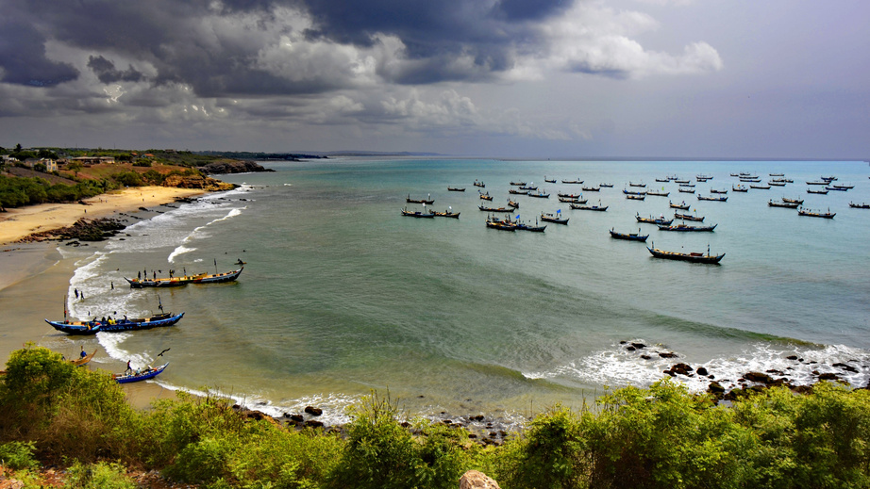
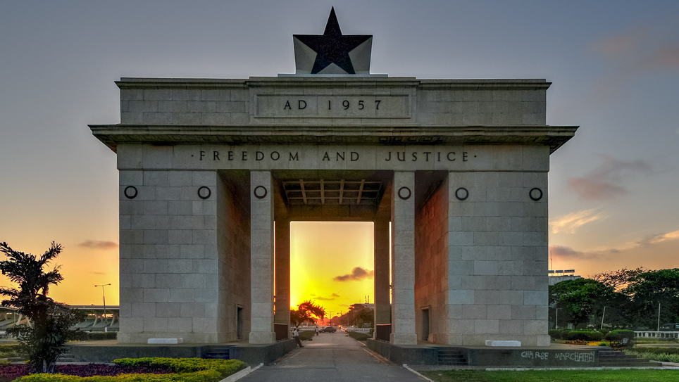
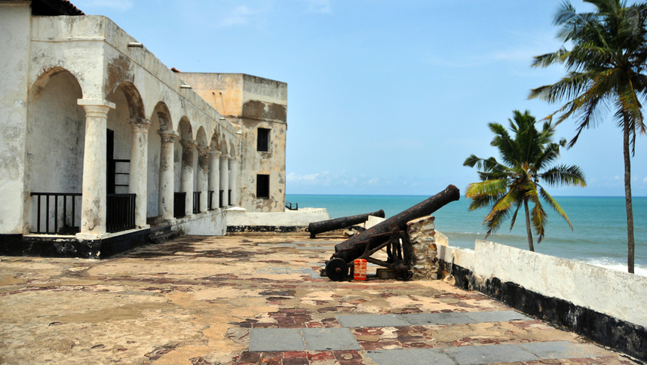
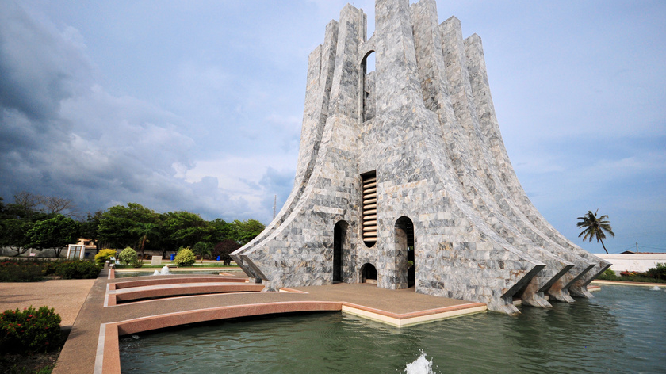
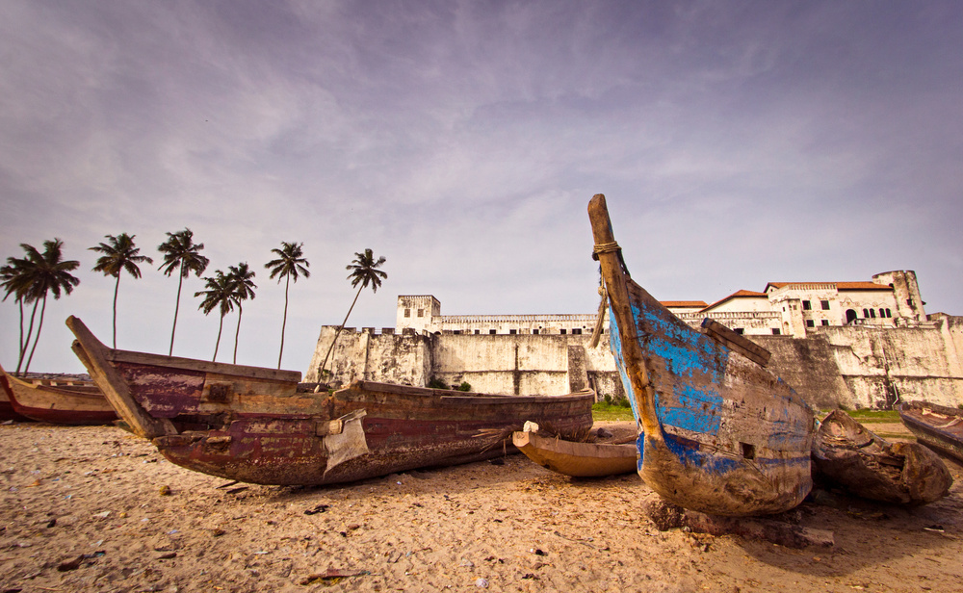
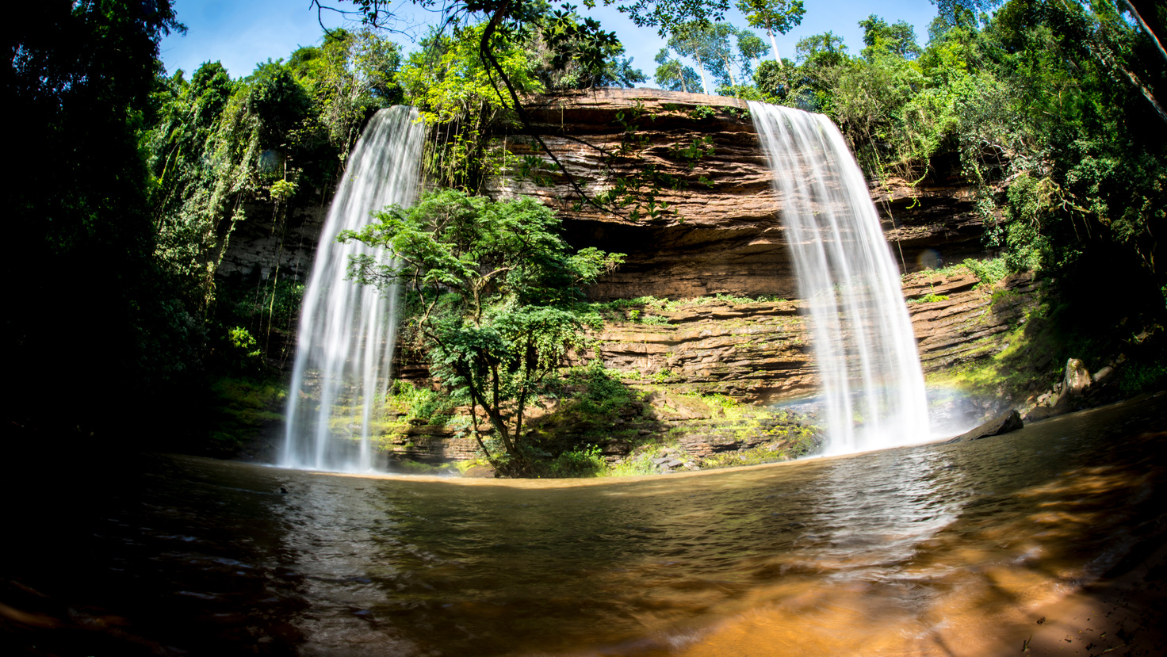
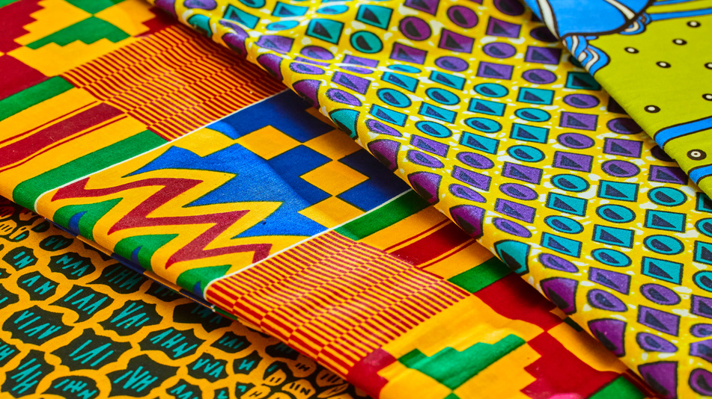
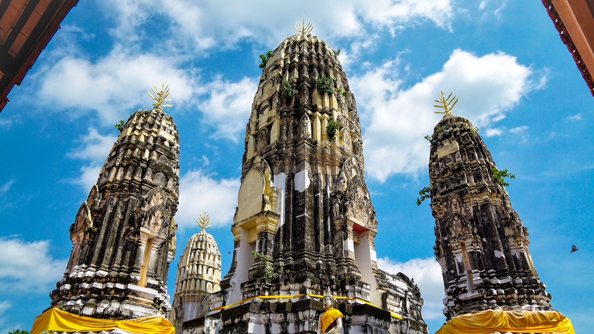
PROPER IMAGERY - GHANA
16
BRAND GUIDELINES 2023

Slide 22
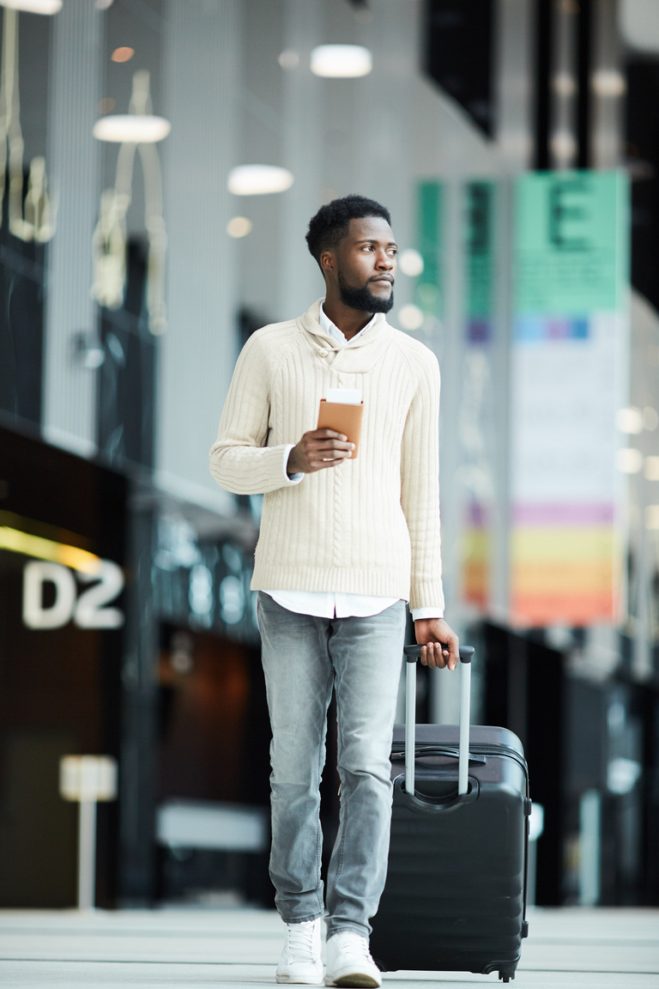
PROPER IMAGERY - TRAVEL
15
BRAND GUIDELINES 2023

Slide 23
EVENT & PR USAGE
19
To maximize PR, all photo must include some form of branded items or marketing props
If possible execs or staff should wear branded Sentra Airways polos for informal occasions or have cabin crew in attendance for formal occasions as co-participants in photos
Execs can choose to wear suit or combine with Sentra branded polo
All press photos. partnerships or agreements should aim to have a photo with business partner involved with Sentra branding
BRAND GUIDELINES 2023

Slide 24
CONTACT INFORMATION
ALL BRAND APPROVALS TO BE REQUESTED BELOW:*
Email Address
marketing@sentraairways.com
Website
www.sentraairways.com/media/brand
BRAND GUIDELINES 2023
*Please allow up to 48 hours for approval

